Slide 1
Fake News Detection

Slide 2
Introduction
Big Data Analysis for Real Time Fake News Detection in Social Media

Slide 3
Prez Says….
Fake News: Made up story with an intention to deceive
Creates confusion about current events

Slide 4
DataSet: Negative Aspects
Detecting So-called Fake News is not a easy task.
Once collected, you must find useful features to determine fake from real news.
Annotation of ground truth of news article is a bottleneck.
Scrape thousands of articles from numerous media outlets of differing biases to collect real news article.

Slide 5
DataSet: Positive Aspects
Fake News dataset available on Kaggle.
Hot topic every now and then, lot of innovation and research going on, kept us motivated through-out.
Useful and advanced Machine Learning libraries reduce the classification efforts, allow us to focus more on real time big data analysis and management.

Slide 6
Features: POS: Part-of-Speach Tagging
POS as Syntactic Feature:
Process of marking up a word in a text (corpus) as corresponding to a particular part of speech, based on both its definition and its context.
Instead of just count, Probability is used as feature, e.g count of a POS Tag in a article, given its total count in corpus.
among all POS, only verb, noun, adjectives are incorporated as part of feature vector.
NLTK Library for POS Tagging in News Articles

Slide 7
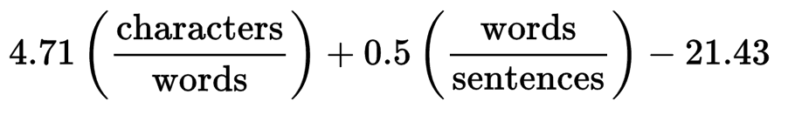
Features: ARI - Automated Readability Index
The automated readability index (ARI) A readability test for English text.
Designed to gauge the understandability of a text.
The formula for calculating the automated readability index is given below: characters, words, sentences are the count in document under consideration.

Slide 8
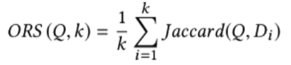
Features: ORS-Online Relevance Score
An average of the Jaccard Similarities between the input text and the news description of the top K links.
Top k links are from Bing search of the input text headline.
k = 10 for all our experiments.

Slide 9
Features: LDA-Latent Dirichlet Allocation
Unsupervised learning model for topic modeling from raw text articles.
In LDA, each document may be viewed as a mixture of various topics where each document is considered to have a set of topics that are assigned to it via LDA.
2 topics are used to train a LDA model over 50000 articles.
The trained model used during testing phase to get LDA probabilities.

Slide 10
Features: 26 Other NLP Features...
Number, and average length of unique and/or non-stop words in the title, content.
Rate of positive, negative words in the content, and/or non-neutral tokens
Sentiment Polarity and Subjectivity of text.
Avg, Min, Max Polarity of positive and negative words....all as separate

Slide 11
Classifier: Random Forest
Operates by constructing a multitude of decision trees at training time and outputting the class that is the mode of the classes (classification) or mean prediction (regression) of the individual trees.
Number of data points 4500.
Number of estimator = 500, max depth of DT = 30
5-Fold Cross Validation

Slide 12
Classifier: Ada Boost
The output of weak learners is combined into a weighted sum that represents the final output of the boosted classifier.
AdaBoost is adaptive in the sense that subsequent weak learners are tweaked in favor of those instances misclassified by previous classifiers
Number of data points 4500.
Number of weak classifiers 500
5-Fold Cross Validation

Slide 13
Result
AdaBoost Performance: Cross Validation Accuracy - 99.78%
Random Forest Performance: Cross Validation Accuracy - 99.64%
Run Time on a single machine: 7 - 10 minutes (average)
Feature Extraction time on single machine: 7 - 12 seconds (for each news article) ~ 4500 data instances generated in about 10 hours.

Slide 14
Conclusion and Future Work
Extraction of the useful features is time consuming
Spark processing on a single machine is time consuming
Utilize better and more widely used machine learning algorithms and NLP concepts
Extraction of high-level features such as satirical articles, author's tone etc.
Support for a language other than English like Chinese, Korean, Spanish etc.

Slide 15
References
[1] GUNASEKARAN, KUMARAN, et al. "Fake News Detection in Social Media.”
[2] https://www.kaggle.com/
[3] Freund, Yoav, and Robert E. Schapire. "A desicion-theoretic generalization of on-line learning and an application to boosting." European conference on computational learning theory. Springer, Berlin, Heidelberg, 1995.
[4] Breiman, Leo. "Random forests." Machine learning 45.1 (2001): 5-32.

Slide 16
The Team
Shalin Amin
Nikhil Kadel
Hardik Bhadja
Antriksh Agarwal
Sreenivas Ventikachalam
Akhilesh Kumar
Vinaya Ganiga
Kritika

